Slide 1
Lecture-5 Gas Condensate Reservoirs
Calculation of Initial Gas and Oil of gas condensate reserviors.

Slide 2
Gas Condensate
Both wet gas and retrograde gas condensate

Slide 3
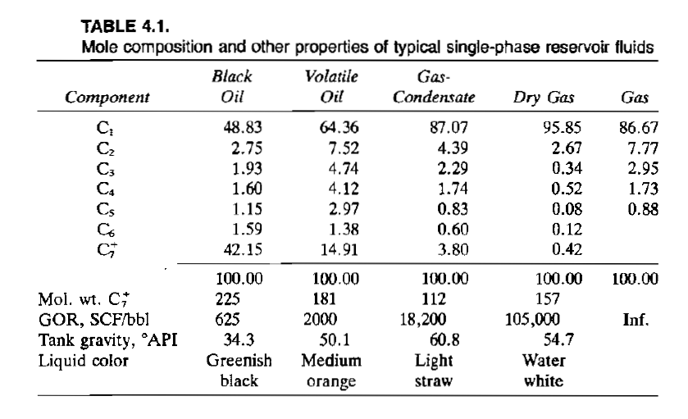
Gas Condensate
GOR increases while the heavy components decreases
تبني اللون

Slide 6
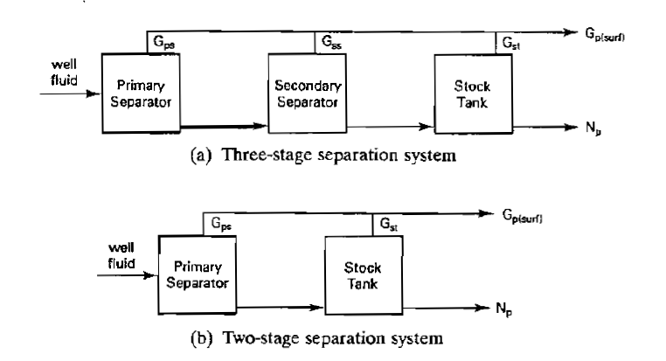
Gas Condensate
The total produced surface gas.
The average specific gravity of the total well fluid.
(By Cragoe)

Slide 8
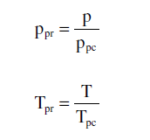

Slide 9
635
425

Slide 11
You can also calculate the specific gravity from the total R
Apply the value of R to find the specific gravity

Slide 12
Initial oil in place =G/R(total)

Slide 13
See you next time inshallah
HAVE A NICE TIME

